Slide 1
Microsoft Azure Training Day: Deploying your Application Faster and Safer

Slide 2
(DO NOT SHOW) Deploying your application faster and safer
Baseline Event | Microsoft Azure Training Day: Migrating applications to the cloud
Recommended Speaker Roles | Field Technical Roles: Regional CDA’/CSA’s, PFE, GBB’s, MVP, MTC TSP’s
Audience | 70% Developers 30% Architects
Length & Version | 60min
Content Level | 200
Deck Contacts | Mark Winters
Training Resources | Session Video -Video 3 Github resource to run the demo’s-Session 3
Accessibility checker | (done)
CHANGE TRACKER
Date | Slide | Description of Update

Slide 3
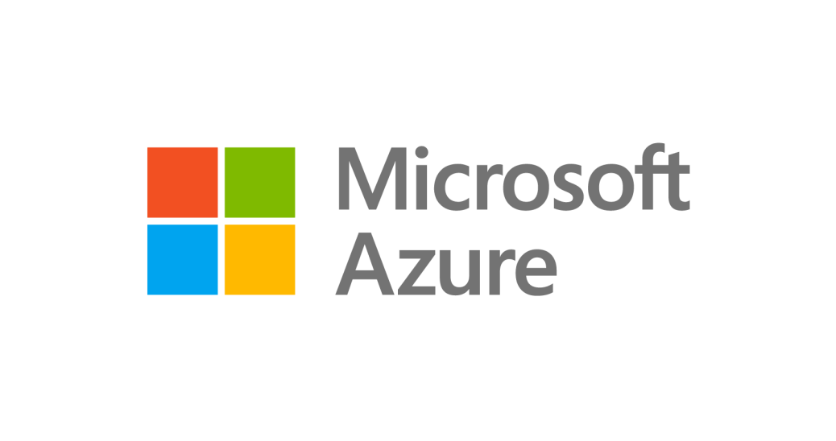
Goals for this session
Learn what DevOps is and isn’t
How does Azure support DevOps
What resources are available to help your organization move to DevOps
Notes:
Lets talk a bit about what we’re going to accomplish today – we’ll discuss why you’d want to move a datacenter hosted app into Azure
We’ll review available endpoints for migration on Azure
We’ll discuss the operational work you’ll no longer need to concern yourself with as you modernize your app infrastructure in Azure
And finally we’ll demo the process and show you the application back in production.

Slide 4


High Performance DevOps Companies Achieve…
46x Deployment
Frequency
2,555x Faster Lead
Time For Changes
Faster
Time to Market
DevOps
$
Increased
Revenue
7x Lower Change
Failure Rate
2,604x Faster Mean
Time to Recover
Source: 2018 Accelerate: State of DevOps: Strategies for a New Economy." N. Forsgren, J. Humble, G. Kim. DevOps Research and Assessment (DORA)

Slide 5
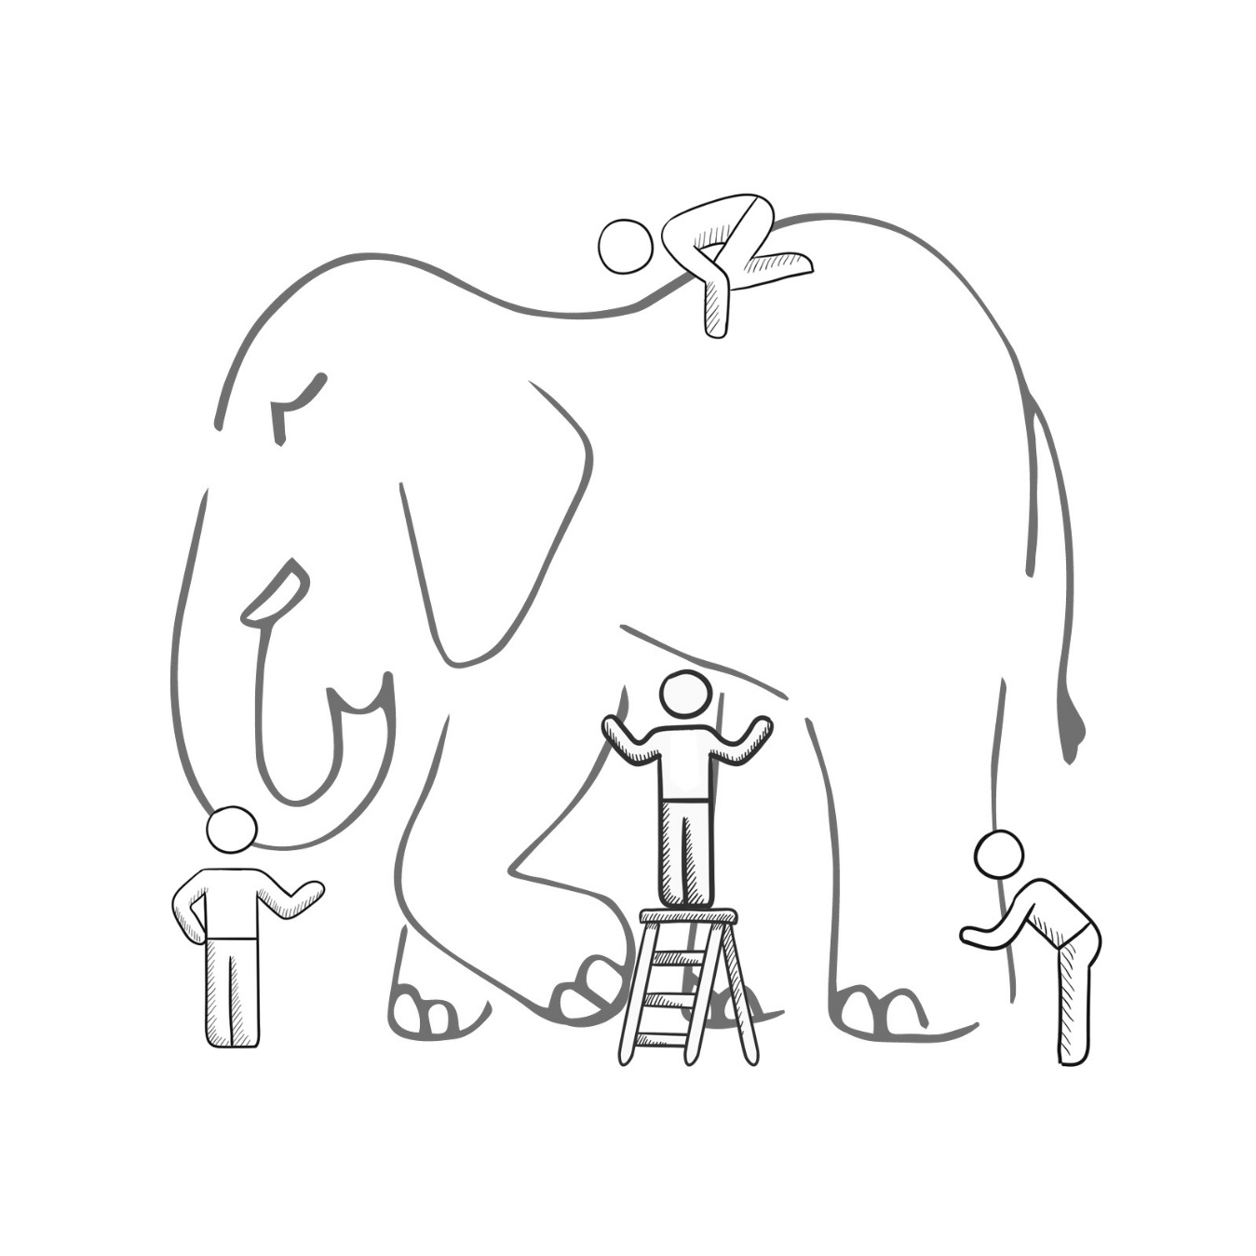
What is DevOps?
It’s a job title
It’s automation
It’s Development and Operations collaboration
It means faster and smaller releases
Notes:
Now I've mentioned DevOps a lot, but what exactly is DevOps. I bet if I ask 10 people in this room what DevOps is, we will get 10 different responses. And I'm not saying anyone elses definition is wrong. But in order to frame this conversation we are having, let me give you Microsoft's Definintion of DevOps

Slide 6
What is DevOps?
People. Process. Products.
Build& Test
Deploy
DevOps is the union of people, process, and products to enable continuous delivery of value to your end users.
“
Continuous Delivery
Develop
Operate
”
Plan & Track
Monitor & Learn
Notes:
DevOps is the union of people, process and products to enable the continuous delivery of value to your end customers

Slide 7

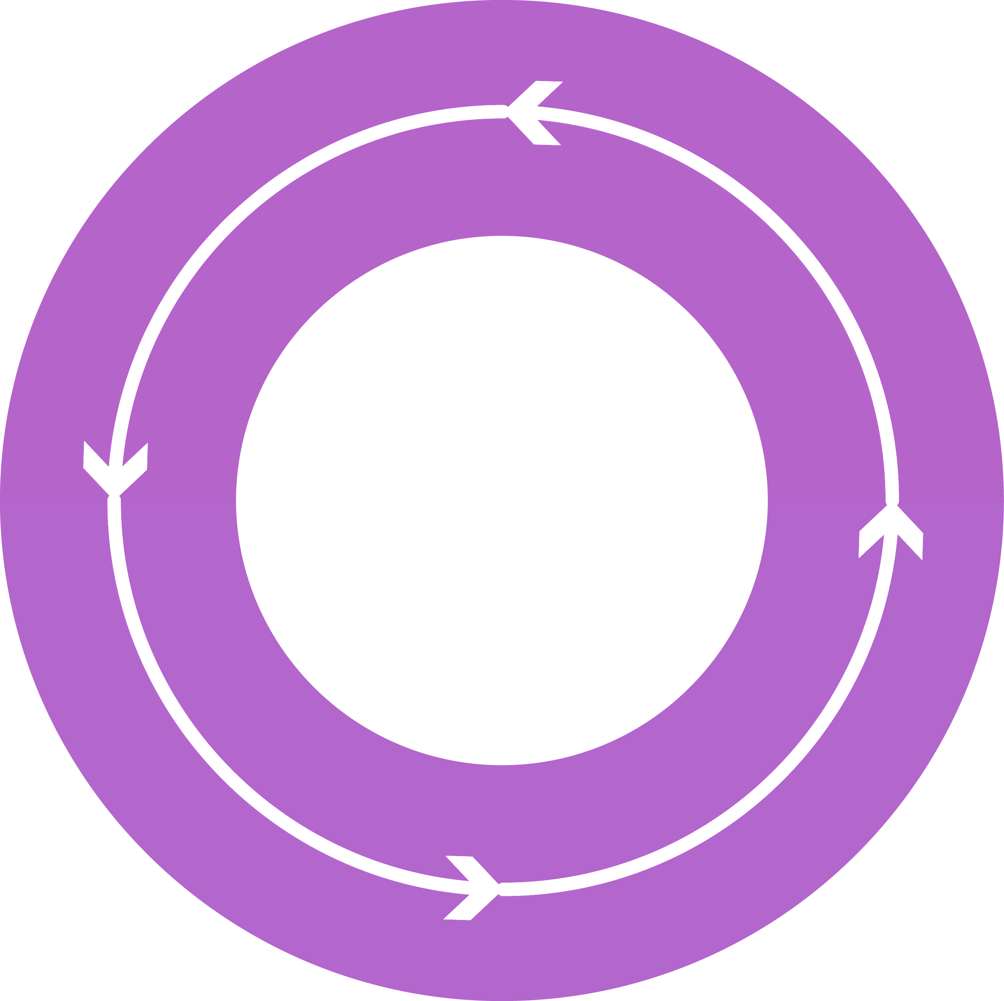




DevOps: the three stage conversation
DEV
OPS
1
People
2
Process
3
Products
Notes:
To implement DevOps successfully, you have to attack all three pillars when writing software. You must address the People, the Process and the Products

Slide 8
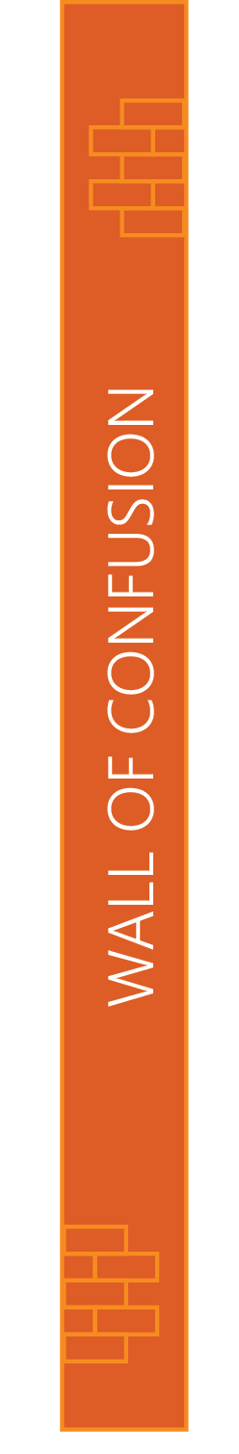
People
DEV
OPS
Notes:
For the people portion, that's the toughest change to make. This is a cultural shift that needs to take place in the organization. Where everybody from the top down all become hyperfocused on continuously delivering value. I don't want to hear, well, that's how we always do things from anyone. Everyone needs to focus on continuously delivering vaue.

Slide 9
Process
1
4
Plan
Monitor + Learn
Development
Production
2
3
Develop + Test
Release
Notes:
For the process, we need to have a process that will let us interate fast enough, yet still deliver code of high enough quality. So what does that mean? I need to be able to plan my sprints, and I need to be able to check my code in and out while tracking against the work I'm doing. And as I'm checking code in and out? Builds need to kick off. Automated Tests need to be run. Security scans need to happen. And if the build are good, an automated system needs to pick up my bits and deploy them into my Dev, QA, UAT all the way out in to production. And why does this need to be automated? Potentially, this can happen many times a day! So we need to make sure the process is consistent and repeatable. Every single time like clock work. And once the code reaches production, it doesn't end there. We still need to be able to monitor our code in production. We need to know things like, is my app up or down, is my app performing well, and what are users really doing in my app? Because answers to those questions let me know if I'm delivering vaue to my end users. And if I am, we can double down on those types of activities in the next sprint. And if we aren't, then we can quickly reprioritize our backlog and course correct.

Slide 10
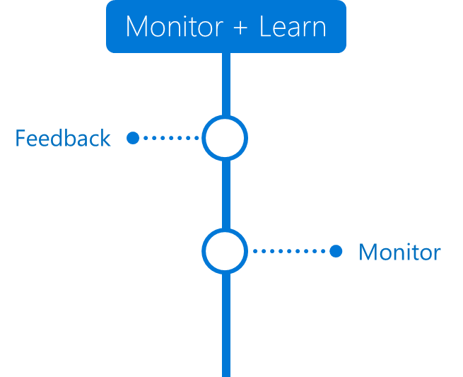
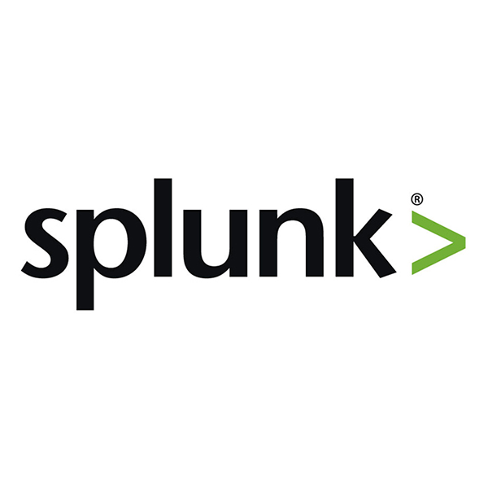
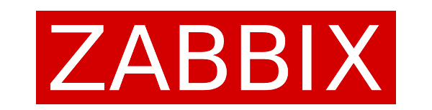
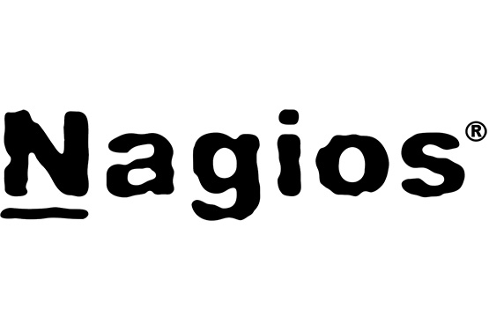
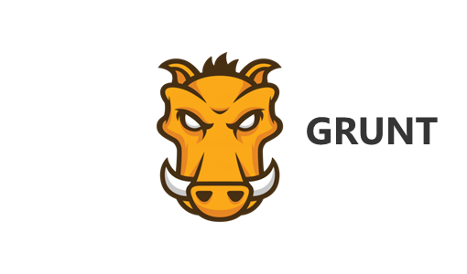
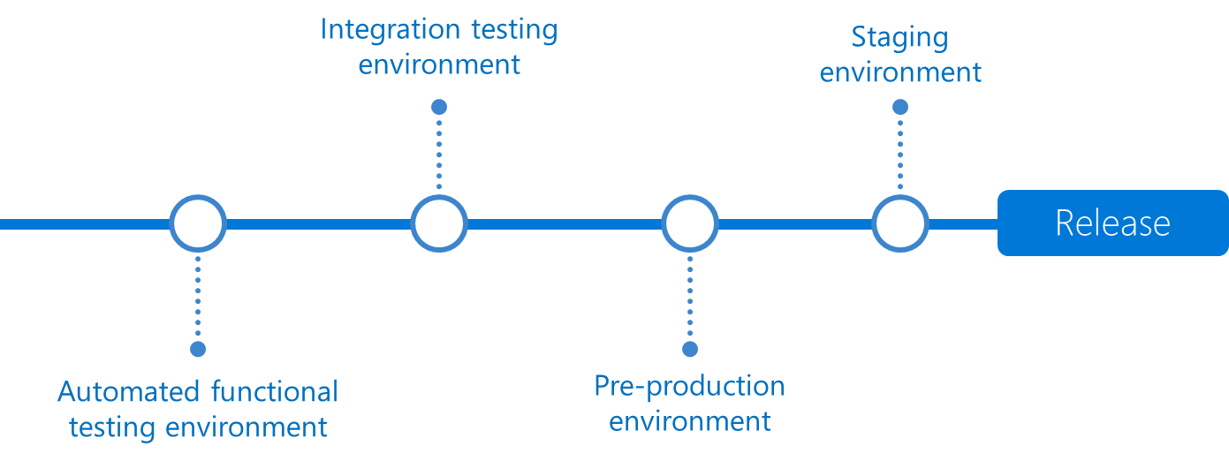
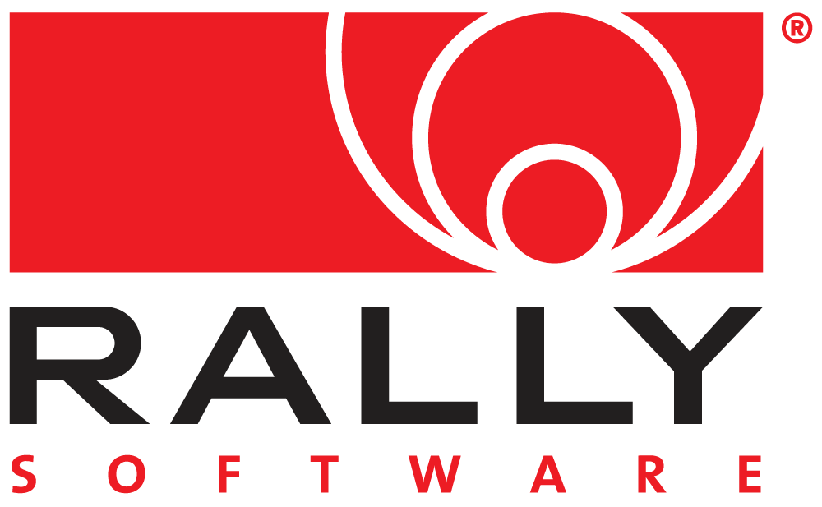
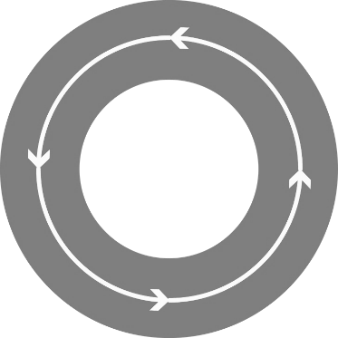

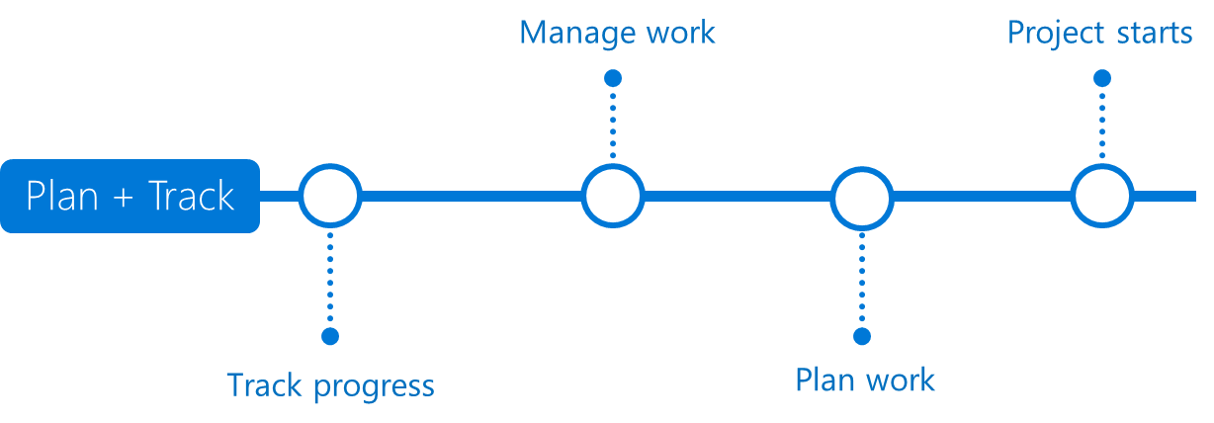

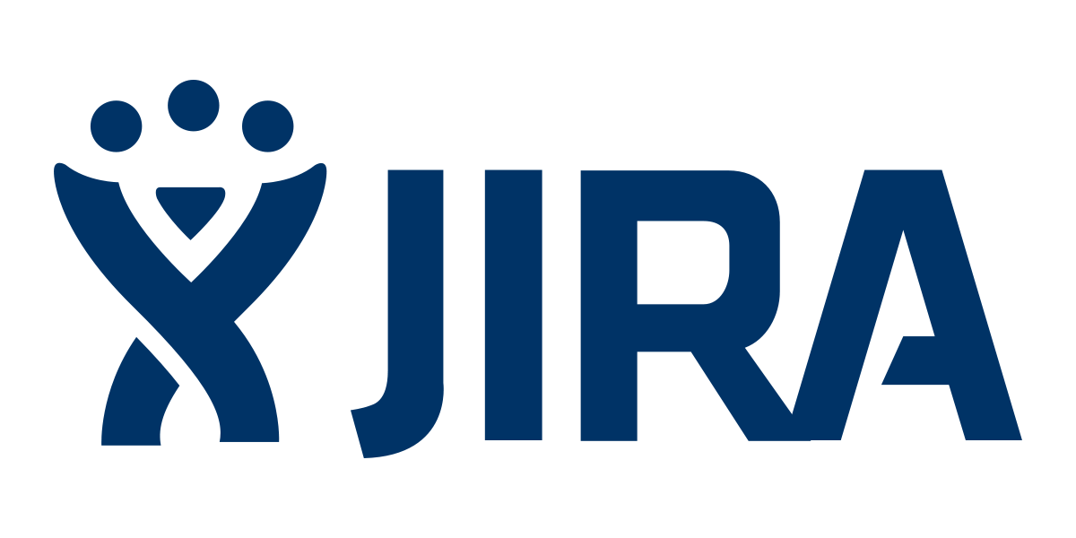
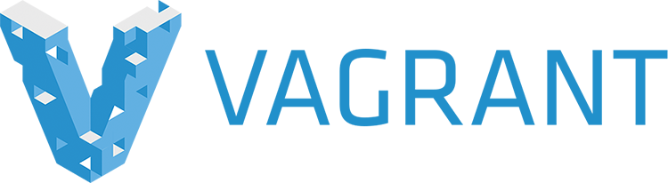




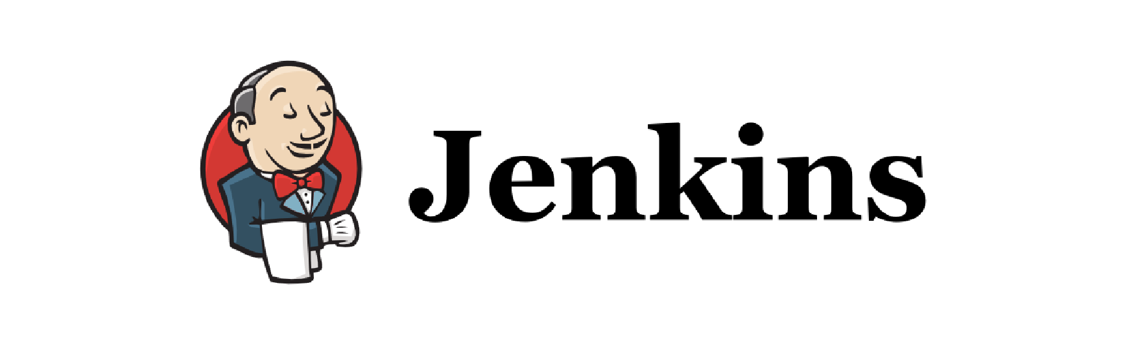
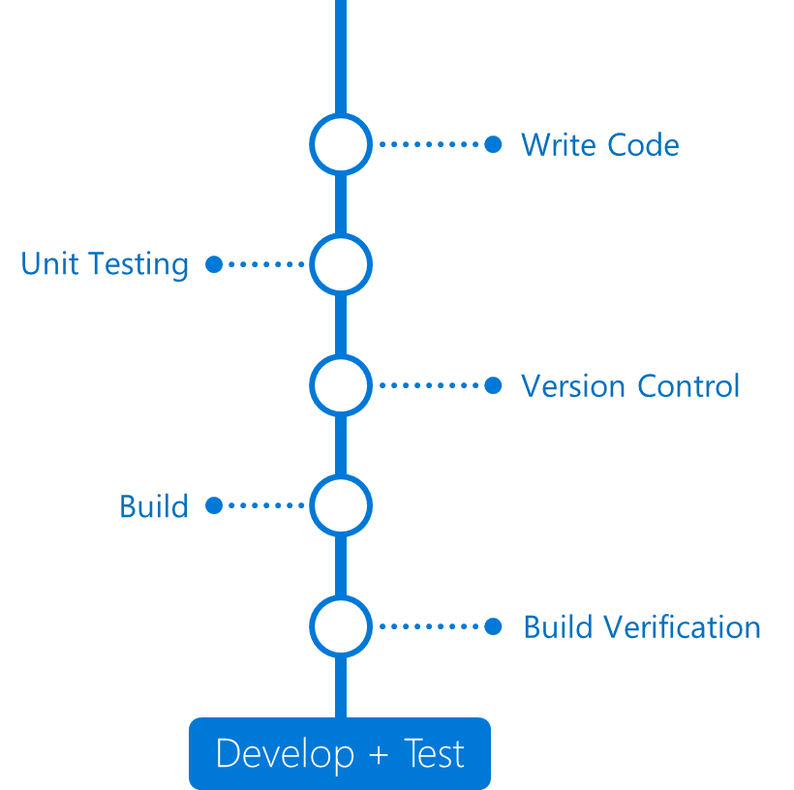
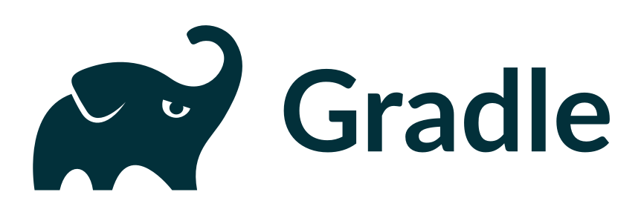
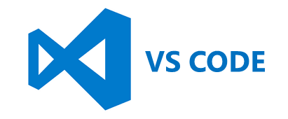
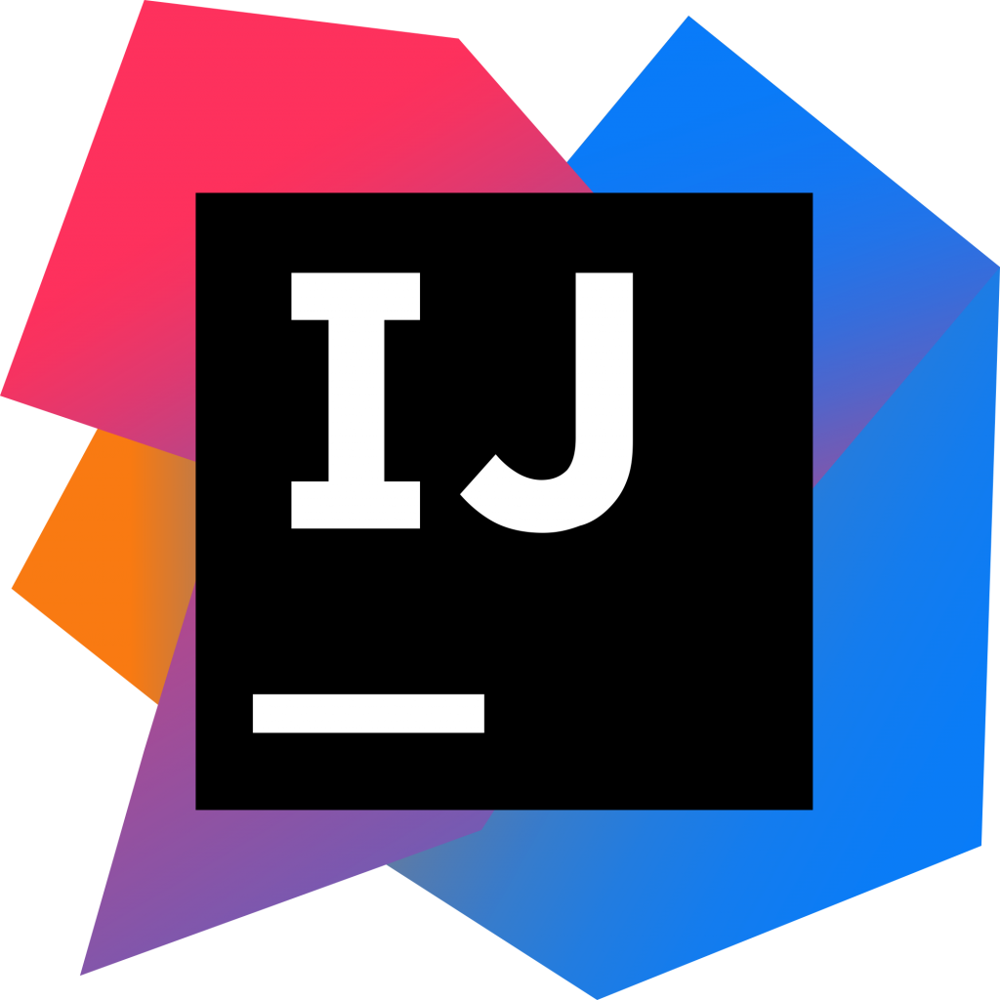
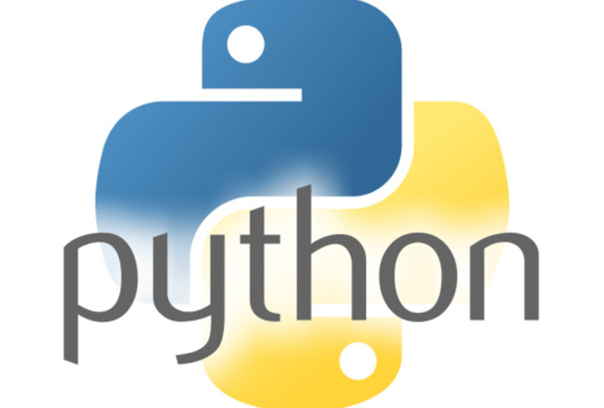
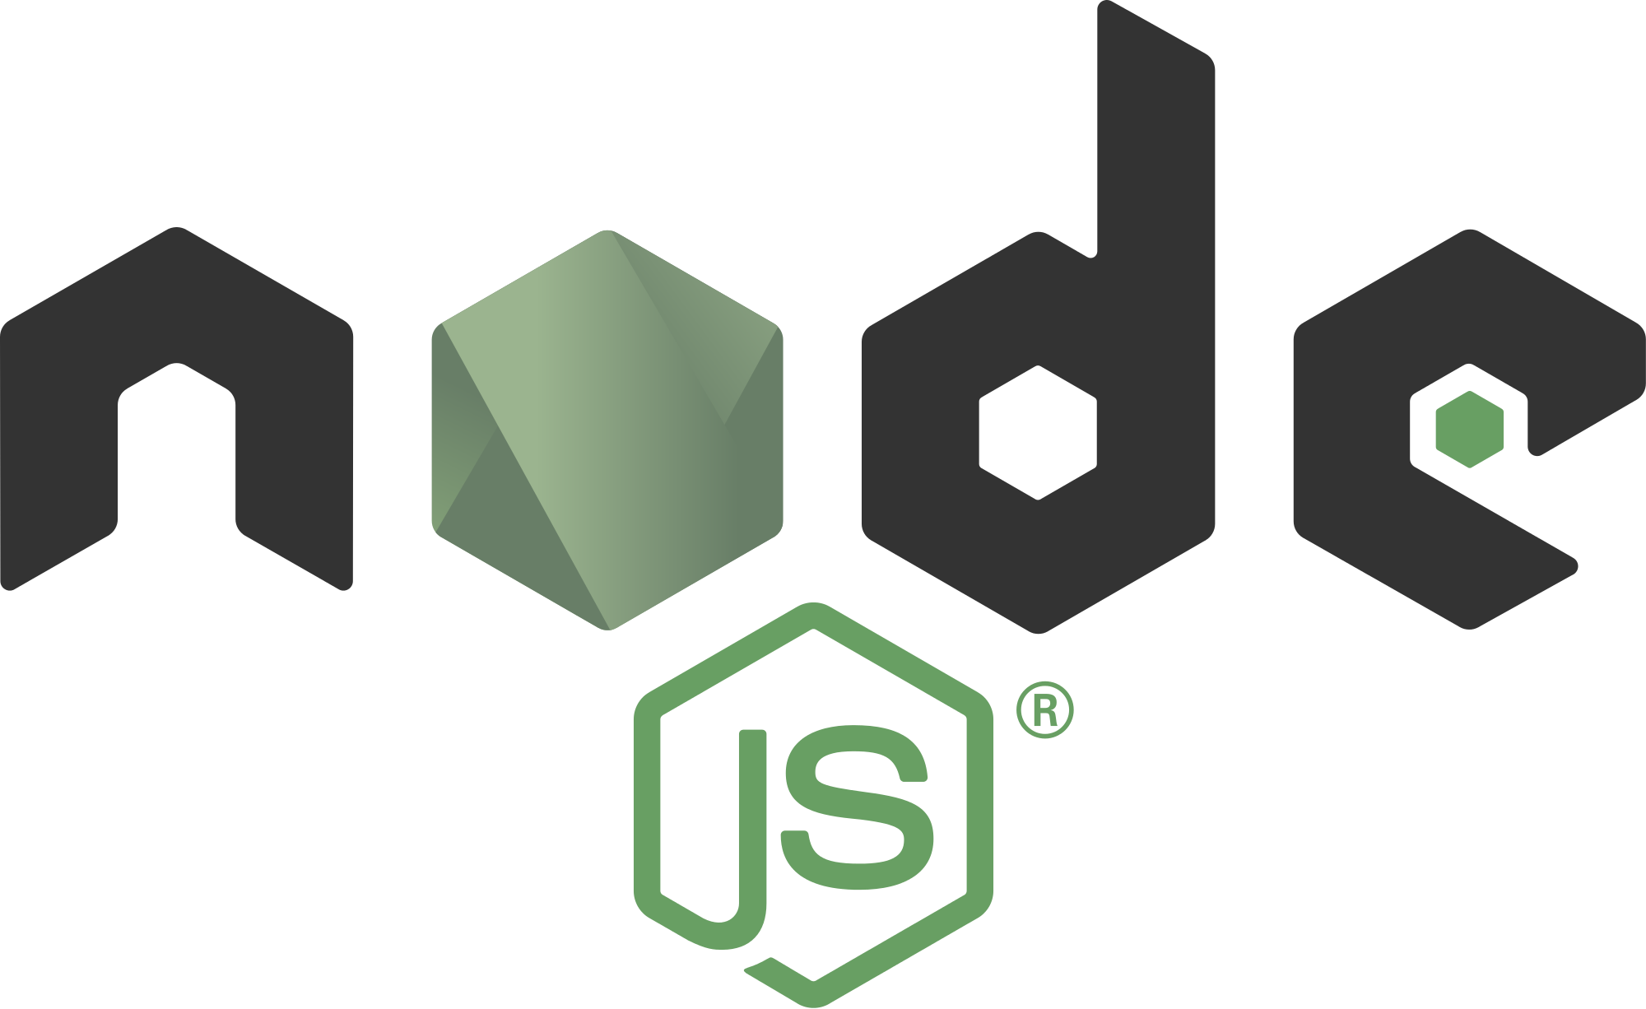
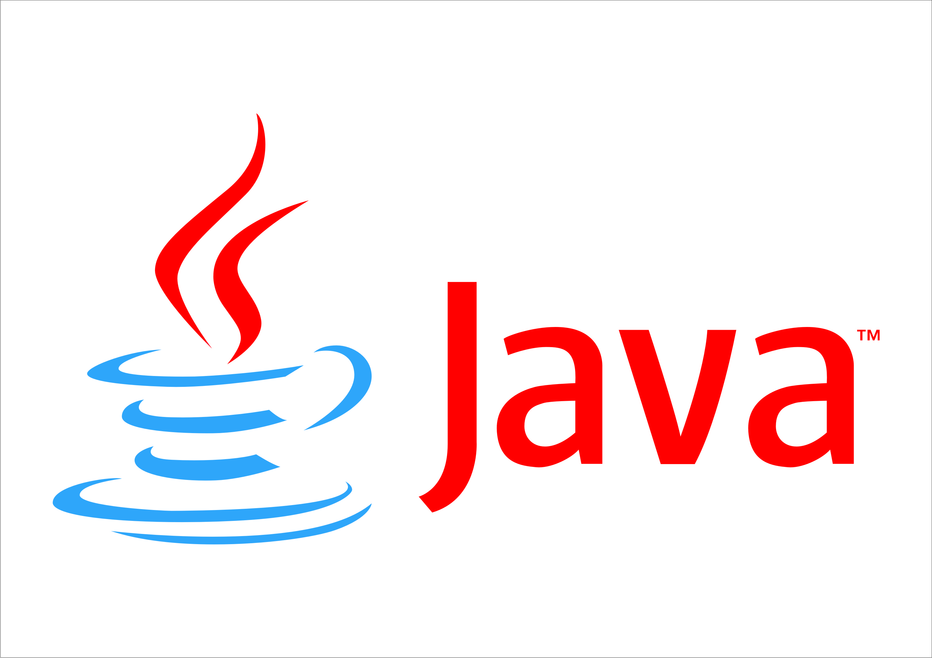

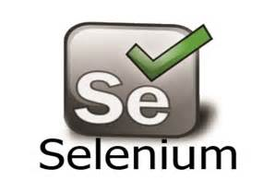
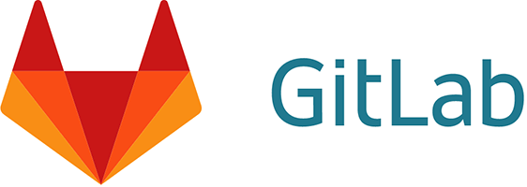
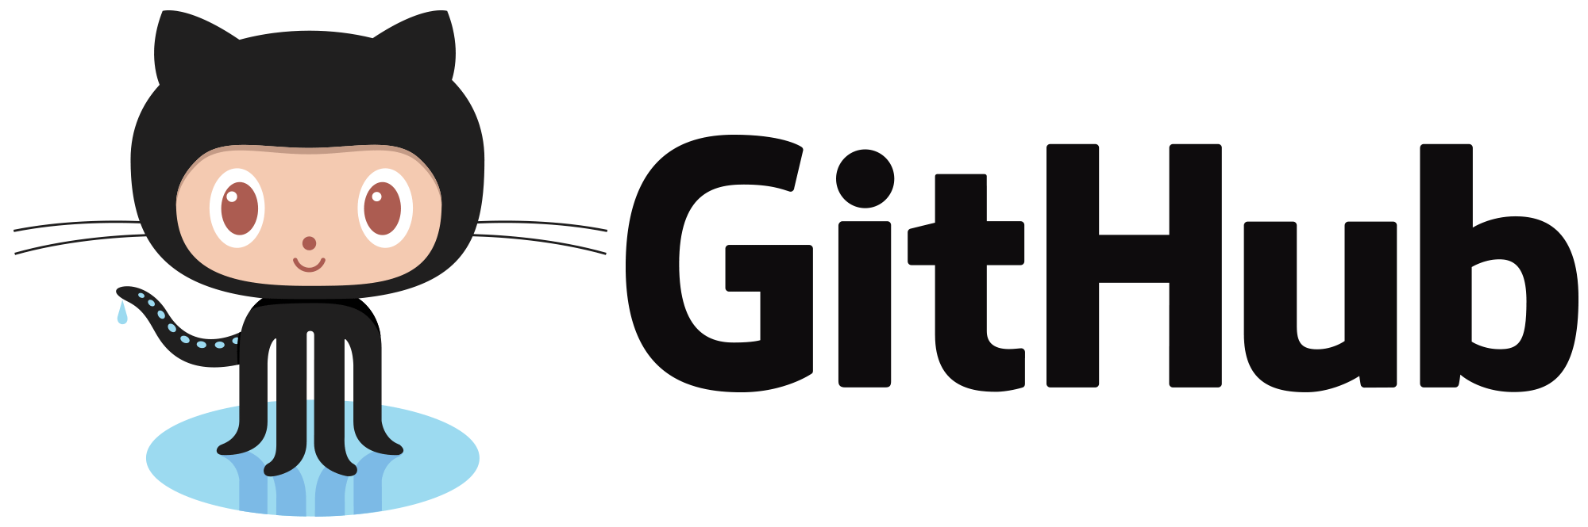
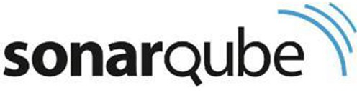
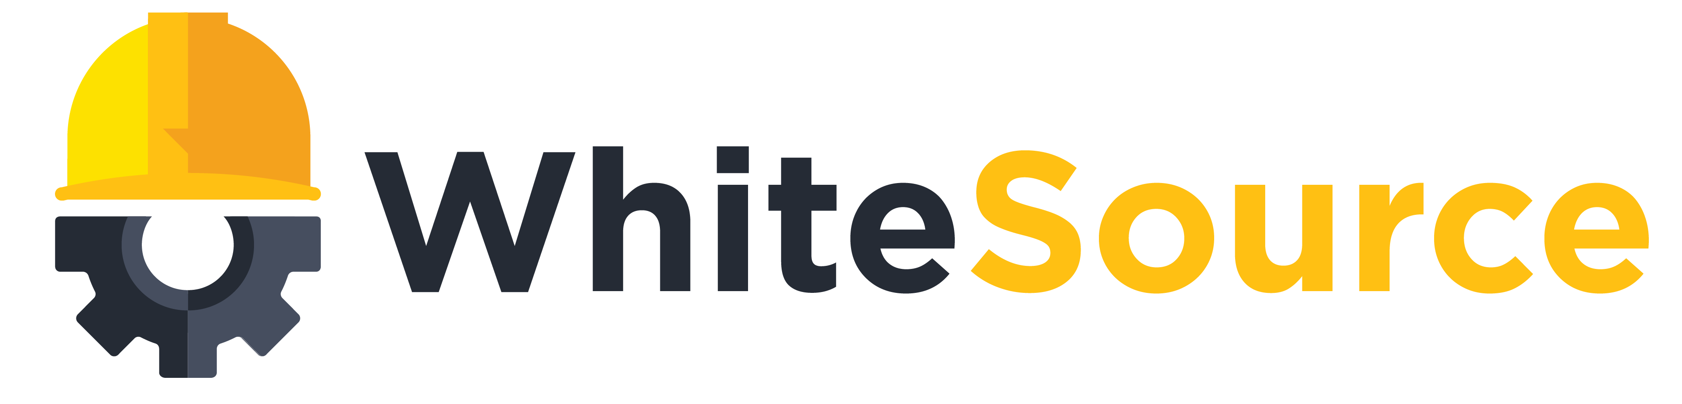
We have LOTS of DevOps
DevOps
DevOps
Notes:
Now all of this requires the right products and tools to help enable all of this. So we need tools that will let us track our work throughout our sprint. We need source control systems that can corrolate our work to our checkins. We need automated build and release systems that can build on everycheckin, run all of our unit tests and automate deployment all the way to production. And we need systems in place to monitor our app in production.
Out there in the world, there are all sorts of tools that do these things. And Azure is an open system, which means you can keep using all of the DevOps tools you are most familiar with.
However, you can replace ALL of them with just one product. Azure DevOps

Slide 11





Introducing Azure DevOps
Azure Boards
Azure Pipelines
Azure Repos
Deliver value to your users faster using proven agile tools to plan, track, and discuss work across your teams.
Build, test, and deploy with CI/CD that works with any language, platform, and cloud. Connect to GitHub or any other Git provider and deploy continuously.
Get unlimited, cloud-hosted private Git repos and collaborate to build better code with pull requests and advanced file management.
Azure Test Plans
Azure Artifacts
➔
Test and ship with confidence using manual and exploratory testing tools.
Create, host, and share packages with your team, and add artifacts to your CI/CD pipelines with a single click.
https://azure.com/devops
Notes:
So does TFS

Slide 12

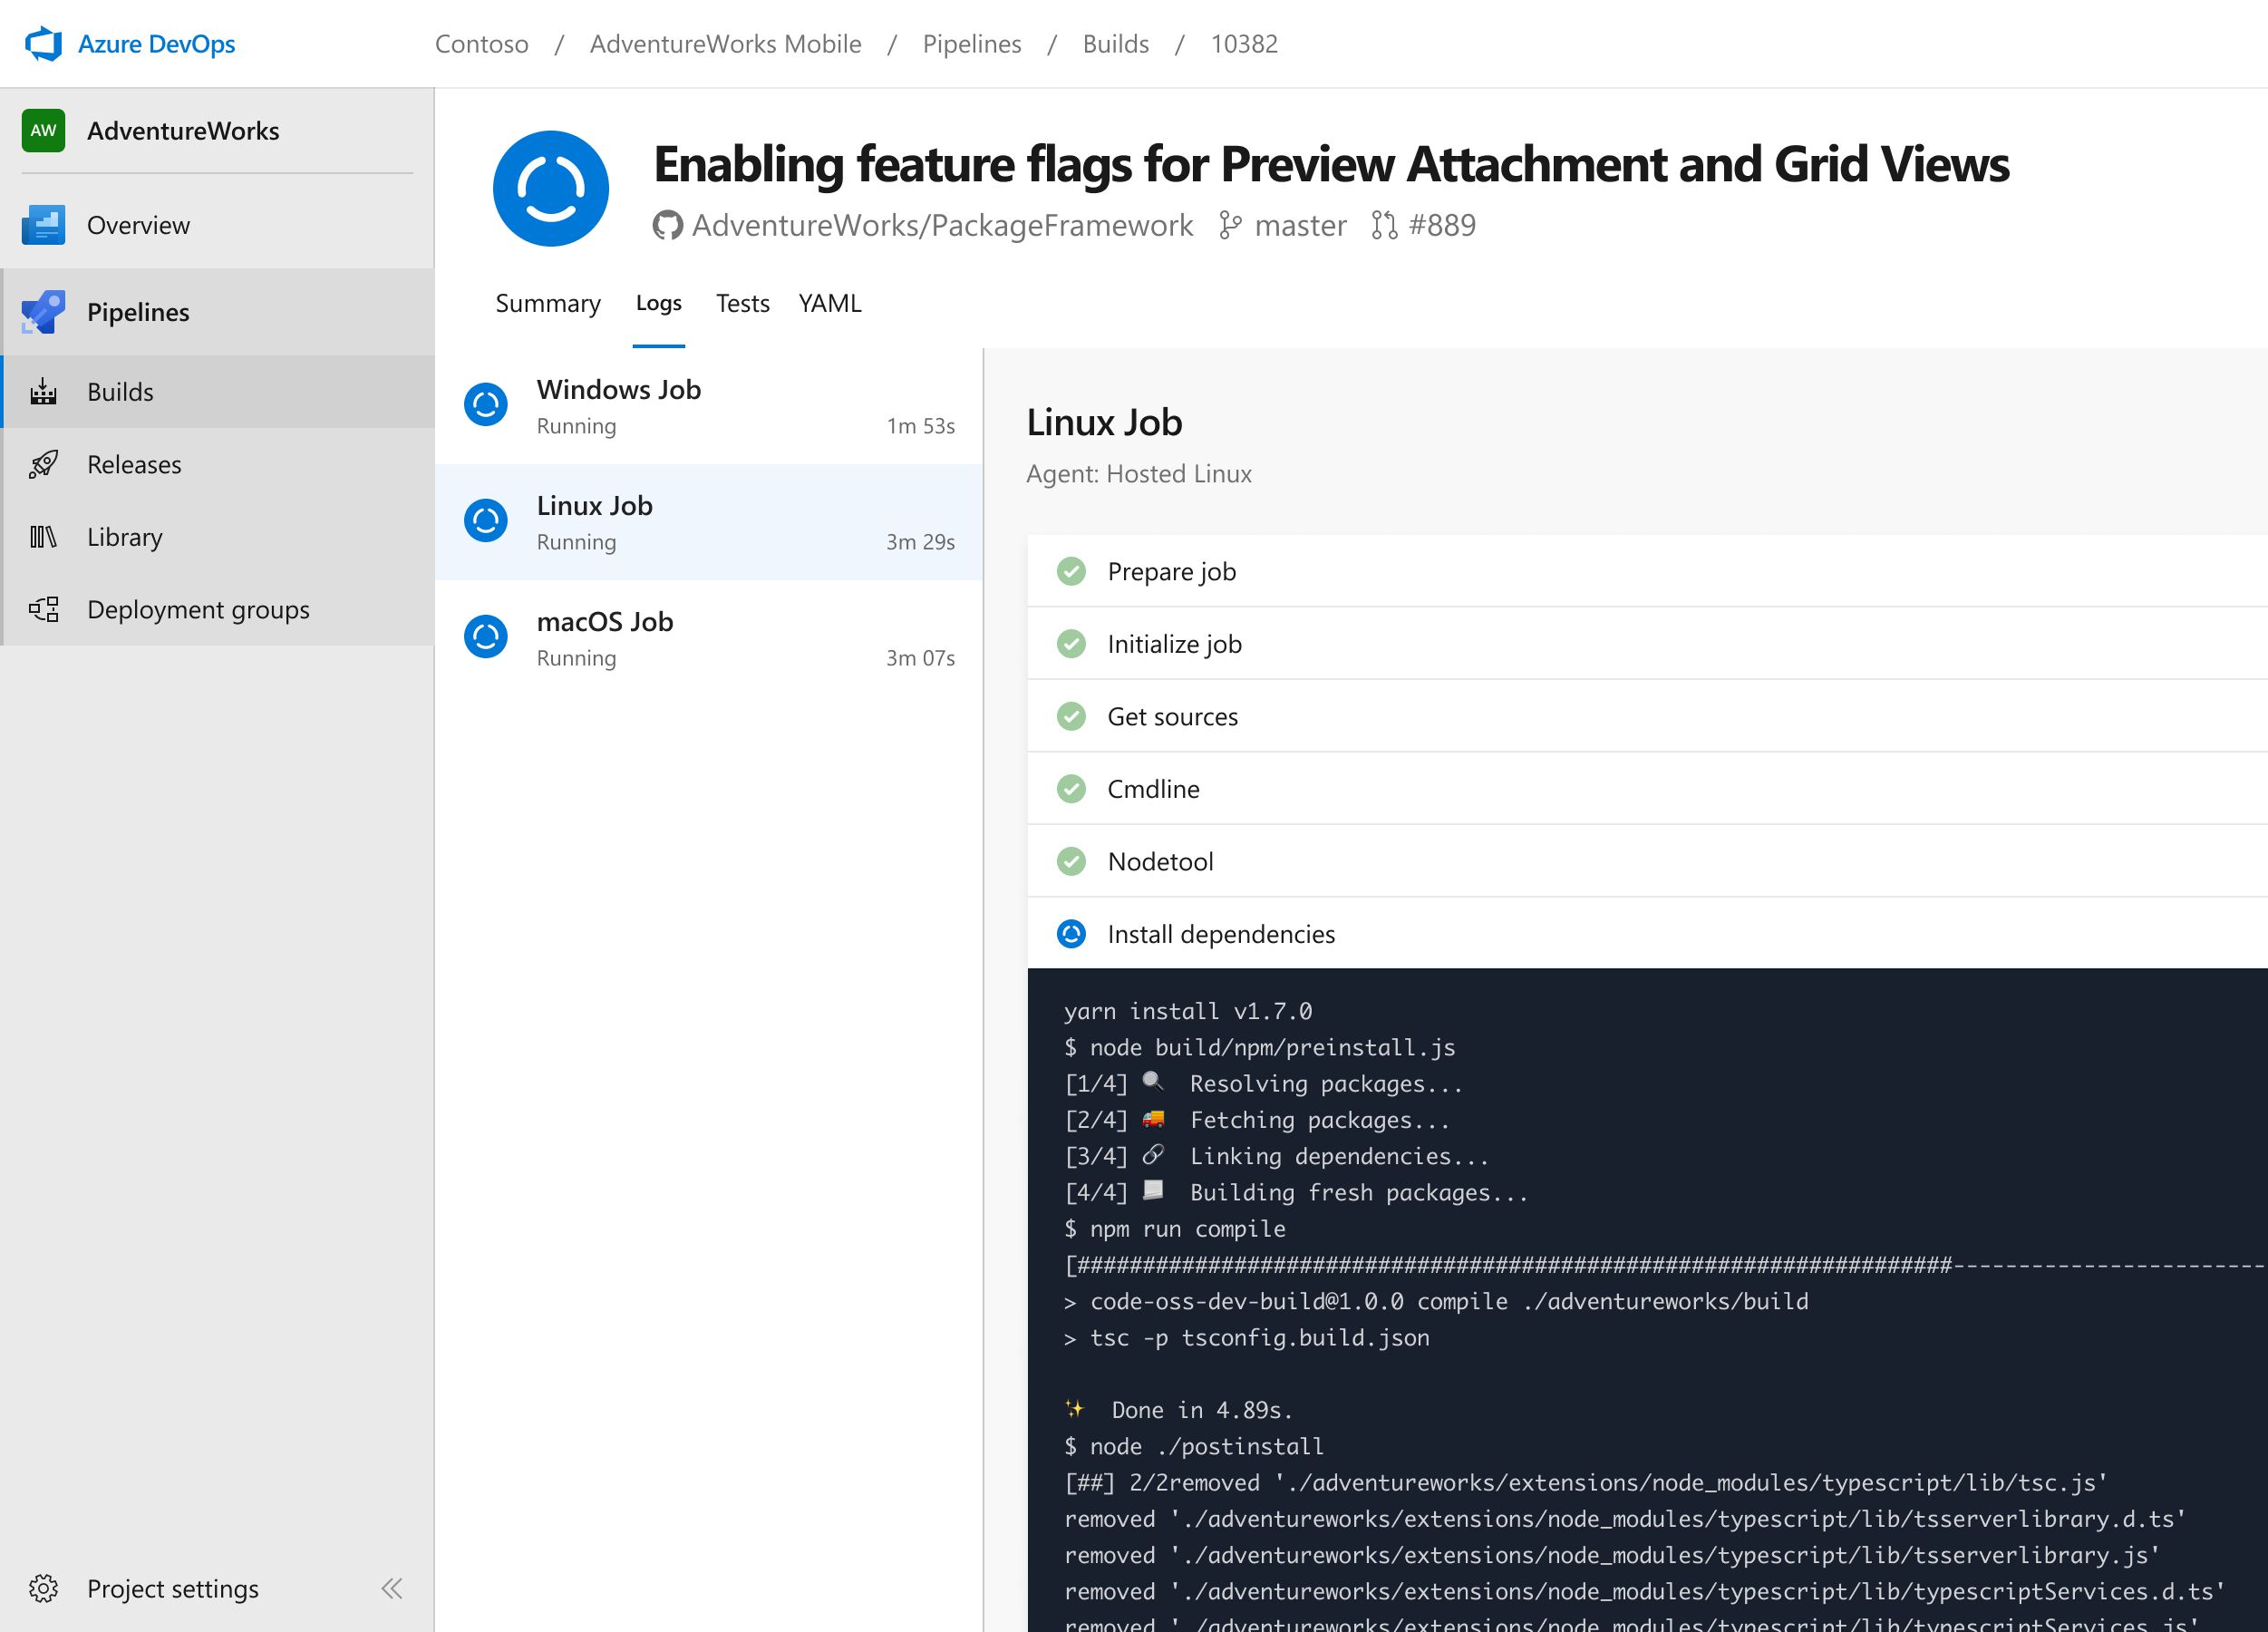


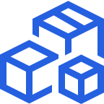

Azure Pipelines
Cloud-hosted pipelines for Linux, Windows and macOS, with unlimited minutes for open source
Any language, any platform, any cloud
Build, test, and deploy Node.js, Python, Java, PHP, Ruby, C/C++, .NET, Android, and iOS apps. Run in parallel on Linux, macOS, and Windows. Deploy to Azure, AWS, GCP or on-premises
Extensible
Explore and implement a wide range of community-built build, test, and deployment tasks, along with hundreds of extensions from Slack to SonarCloud. Support for YAML, reporting and more
Containers and Kubernetes
Easily build and push images to container registries like Docker Hub and Azure Container Registry. Deploy containers to individual hosts or Kubernetes.
Best-in-class for open source
Ensure fast continuous integration/continuous delivery (CI/CD) pipelines for every open source project. Get unlimited build minutes for all open source projects with up to 10 free parallel jobs across Linux, macOS and Windows
➔
https://azure.com/pipelines
Notes:
Azure Pipelines is the perfect launchpad for your code – automating your builds and deployments so you spend less time with the nuts and bolts and more time being creative

Slide 13


Azure Pipelines
Microsoft Open Source
Free unlimited build minutes for public projects
Up to 10 free parallel jobs across Windows, Linux and macOS
➔
https://azure.com/pipelines
Notes:
All the builds you need, using the power of Azure you get one service that gives you unlimited build minutes where you can build on Windows Mac and Linux in parallel using a single build YAML file.

Slide 14

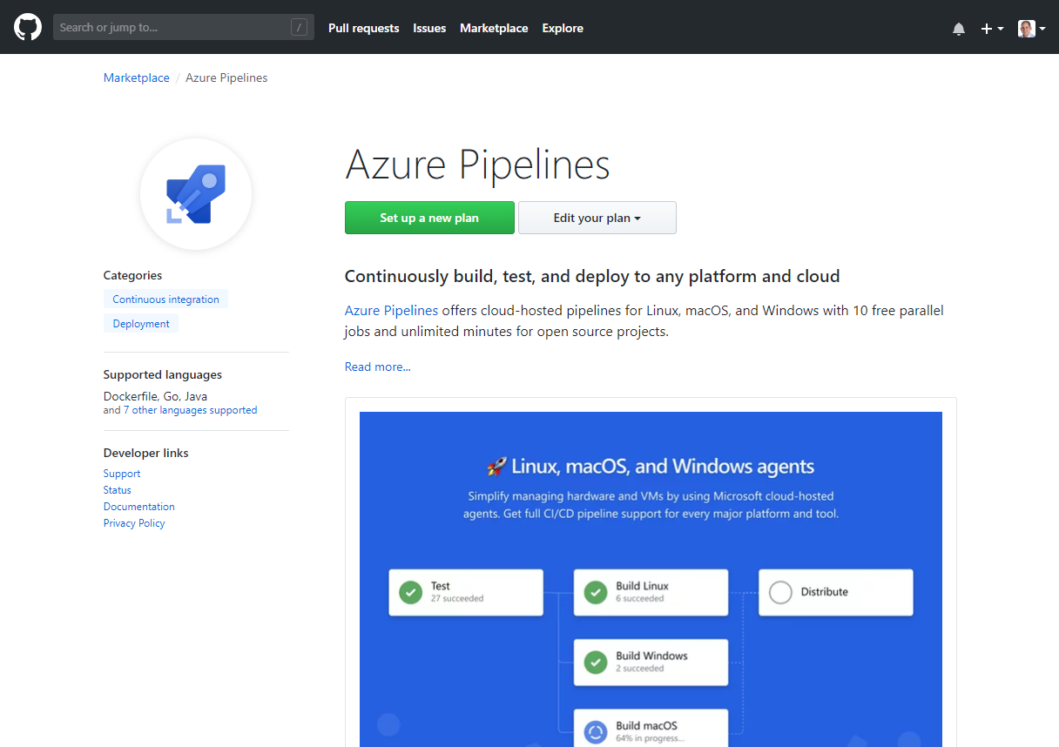
Integrated with GitHub
Azure Pipelines available now to any developer from the GitHub Marketplace

Slide 15

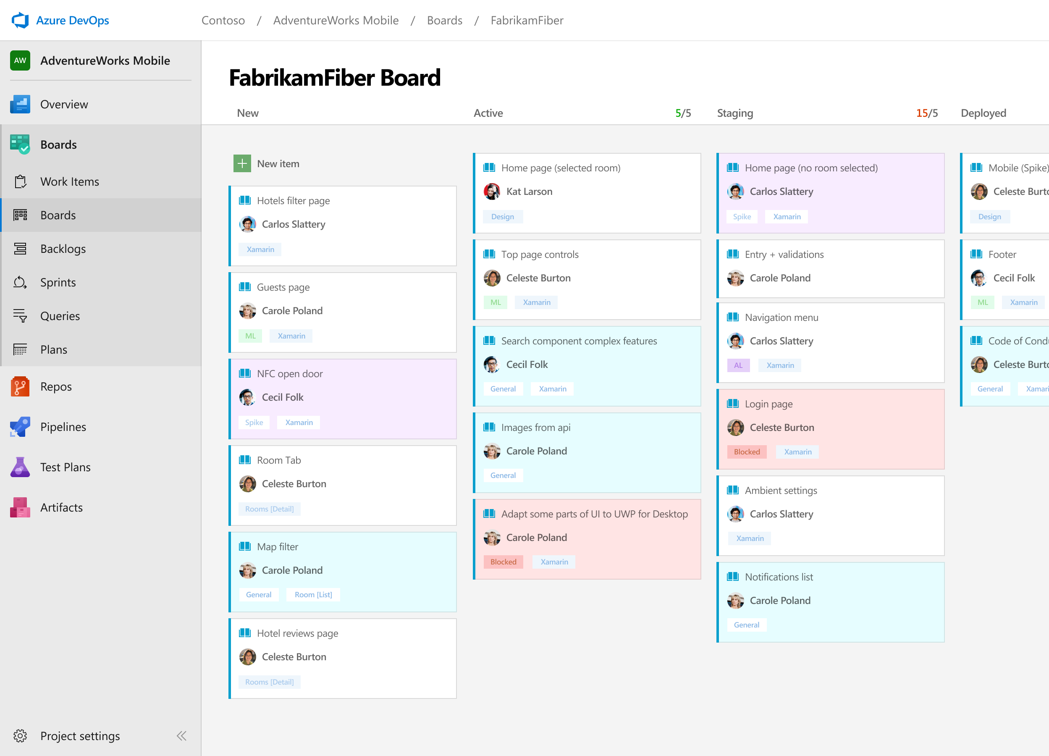



Azure Boards
Track work with Kanban boards, backlogs, team dashboards, and custom reporting
Connected from idea to release
Track all your ideas at every development stage and keep your team aligned with all code changes linked directly to work items.
Scrum ready
Use built-in scrum boards and planning tools to help your teams run sprints, stand-ups, and planning meetings.
Project insights
Gain new insights into the health and status of your project with powerful analytics tools and dashboard widgets.
➔
https://azure.com/devops
Notes:
Combine Kanban boards and drag-and-drop sprint planning with comprehensive traceability and reporting for the perfect home for all your ideas–big and small.

Slide 16
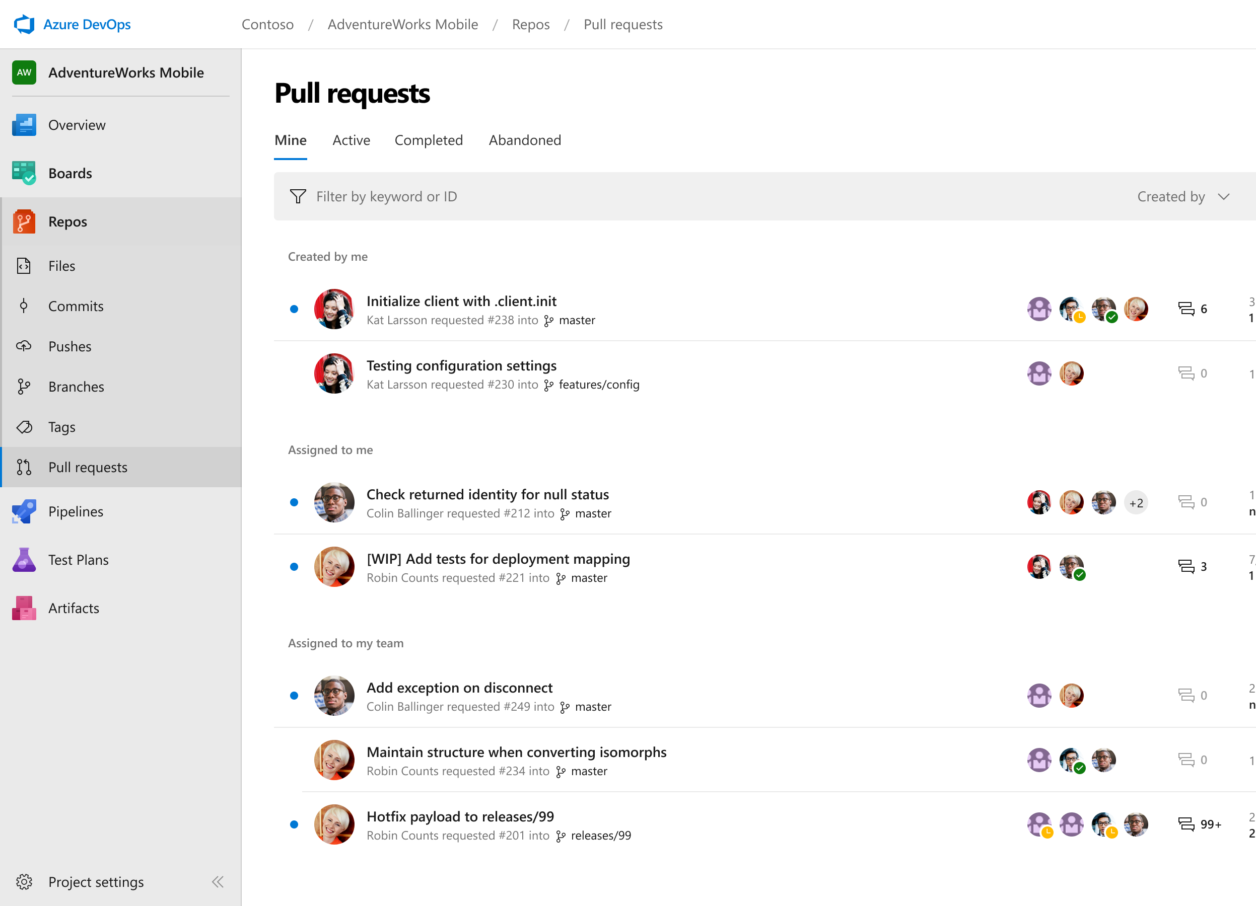
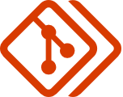
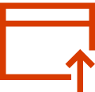

Azure Repos
Unlimited private Git repo hosting and support for TFVC that scales from a hobby project to the world’s largest Git repositories
Works with your Git client
Securely connect with and push code into your Git repos from any IDE, editor, or Git client.
Web hooks and API integration
Add validations and extensions from the marketplace or build your own using web hooks and REST APIs.
Semantic code search
Quickly find what you’re looking for with code-aware search that understands classes and variables.
➔
https://azure.com/devops
Notes:
Collaborate on code changes with threaded discussion and continuous integration for each change. Use forks to promote collaboration with Inner Source workflows.

Slide 17
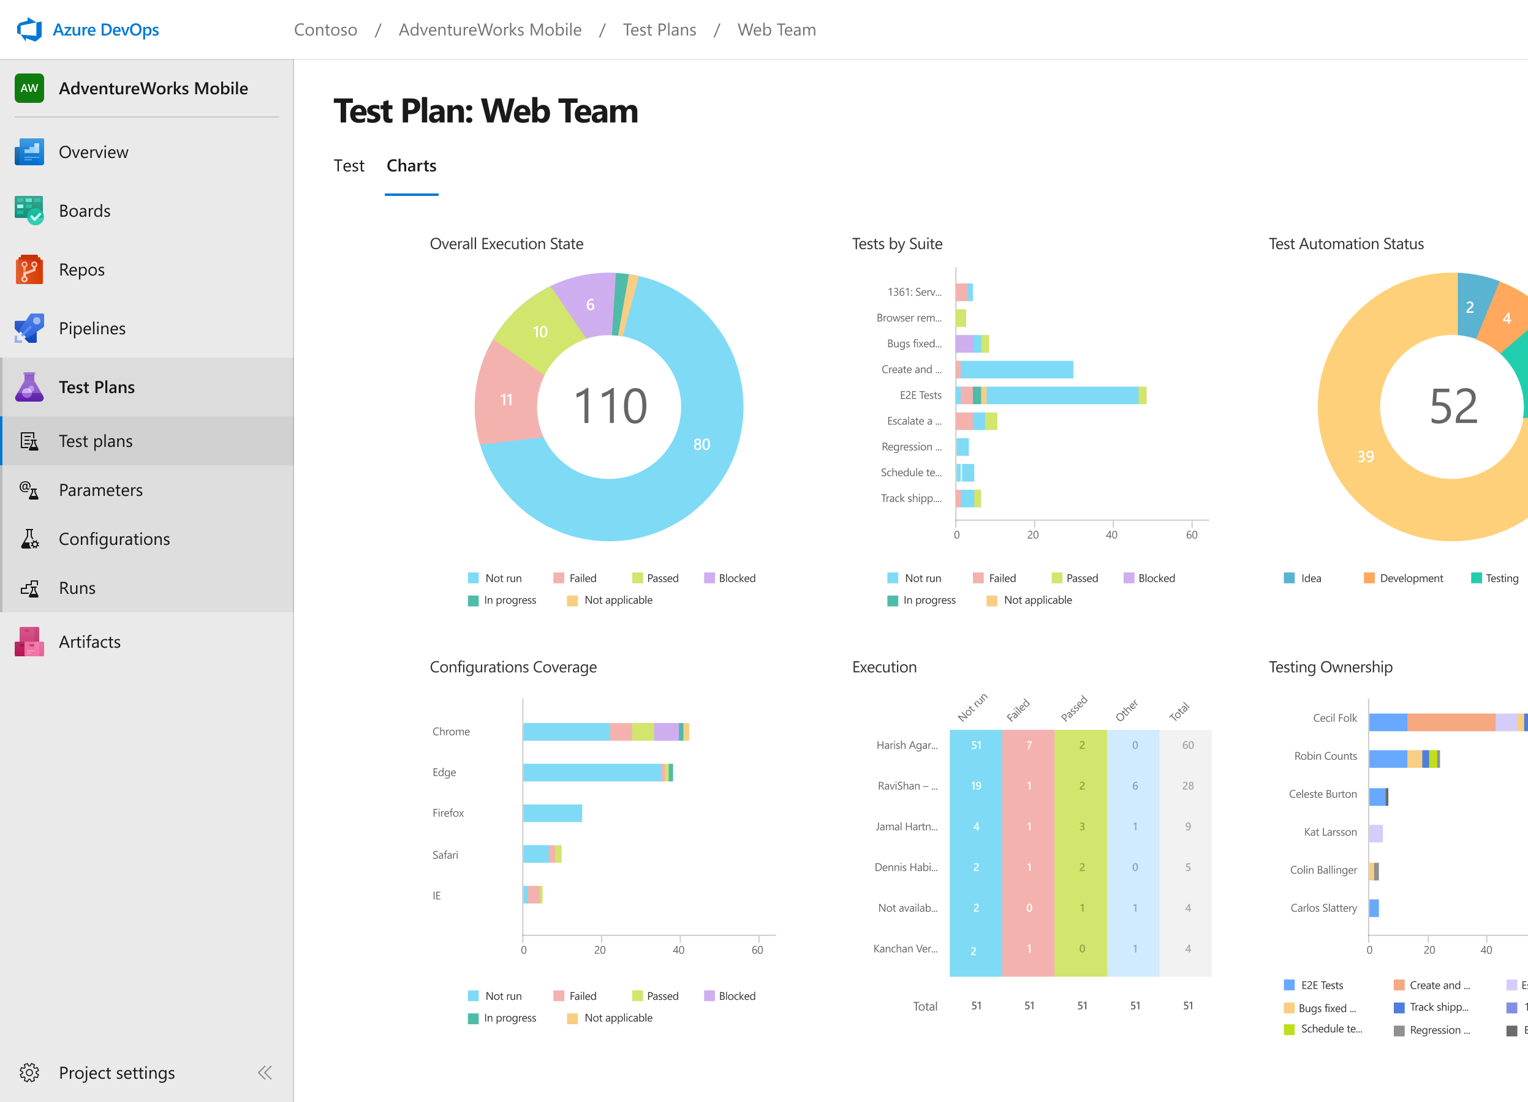
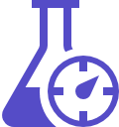

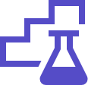
Azure Test Plans
Get end-to-end traceability. Run tests and log defects from your browser. Track and assess quality throughout your testing lifecycle.
Capture rich data
Capture rich scenario data as you execute tests to make discovered defects actionable. Explore user stories without test cases or test steps. You can create test cases directly from your exploratory test sessions.
Test across web and desktop
Test your application where it lives. Complete scripted tests across desktop or web scenarios. Test on-premises application from the cloud and vice-versa.
Get end-to-end traceability
Leverage the same test tools across your engineers and user acceptance testing stakeholders. Pay for the tools only when you need them.
➔
https://azure.com/devops
Notes:
Collaborate on code changes with threaded discussion and continuous integration for each change. Use forks to promote collaboration with Inner Source workflows.

Slide 18
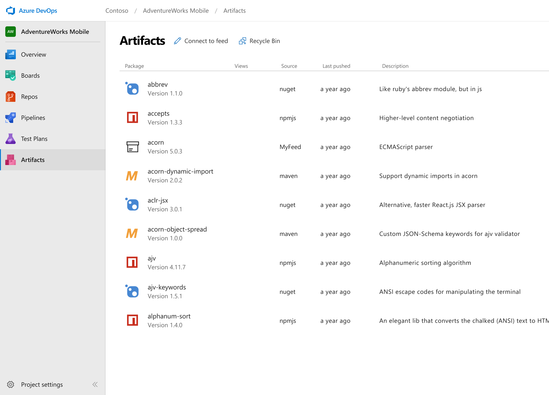



Azure Artifacts
Create and share Maven, npm, and NuGet package feeds from public and private sources – fully integrated into CI/CD pipelines
Manage all package types
Get universal artifact management for Maven, npm, and NuGet.
Add packages to any pipeline
Share packages, and use built-in CI/CD, versioning, and testing.
Share code efficiently
Easily share code across small teams and large enterprises.
➔
https://azure.com/devops
Notes:
Collaborate on code changes with threaded discussion and continuous integration for each change. Use forks to promote collaboration with Inner Source workflows.

Slide 19




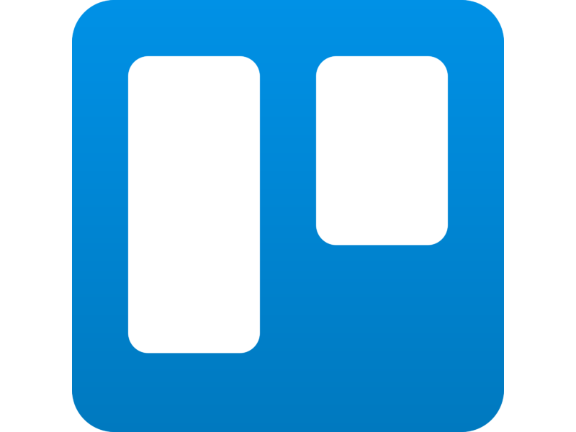
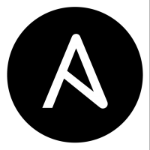

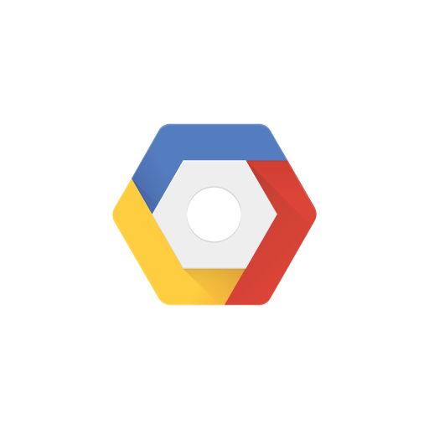

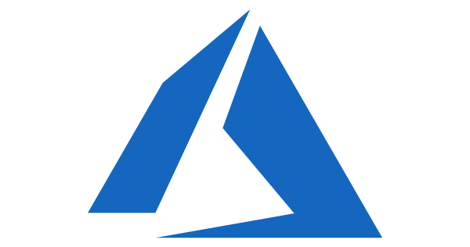

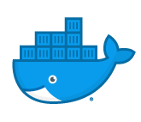
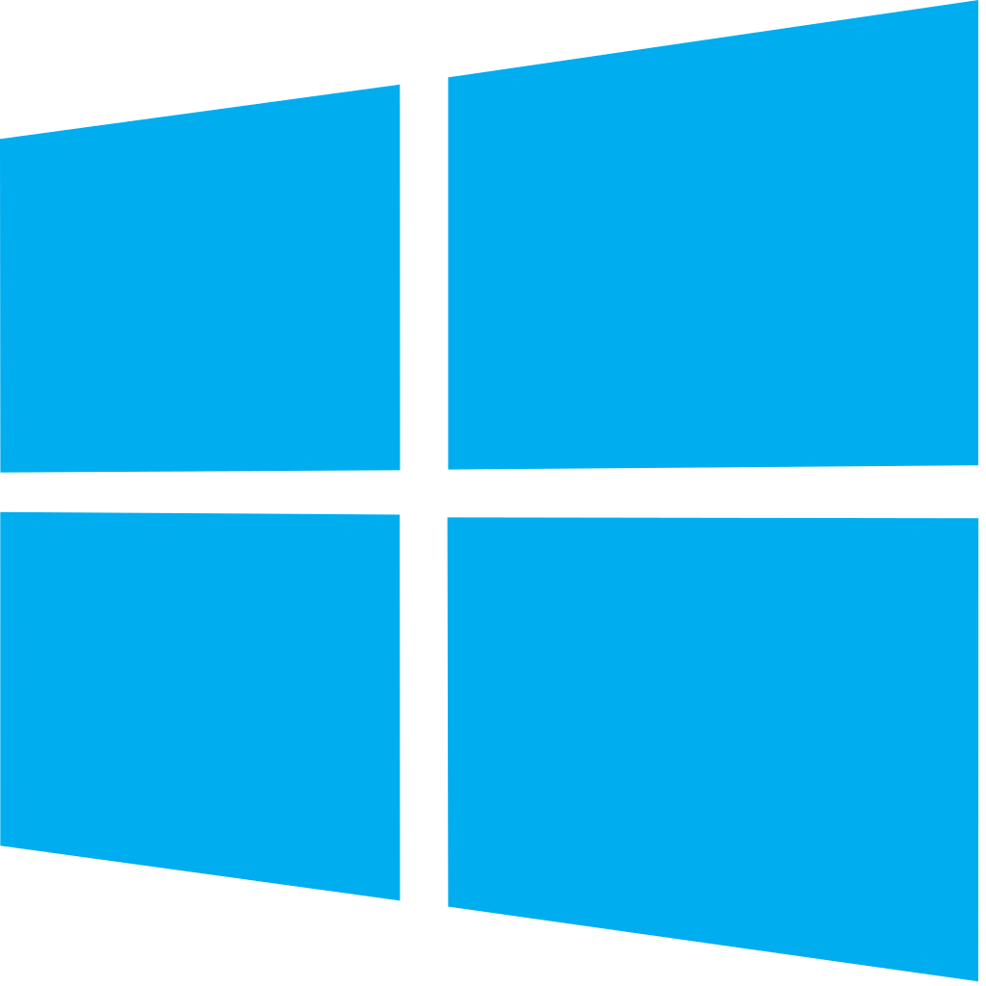


Azure DevOps: Choose the tools and clouds you love
Azure DevOps lets developers choose the tools that are right for them
Mix and match to create workflows with tools from Microsoft, open source or your favorite 3rd party tools
Target any cloud, on-prem or both and deploy to the servers you need

Slide 20
DevOps at Microsoft
Azure DevOps is the toolchain of choice for Microsoft engineering with over 90,000 internal users
➔
https://aka.ms/DevOpsAtMicrosoft
372k
Pull Requests per month
4.4m
Builds per month
5m
Work items viewed per day
78,000
Deployments per day
2m
Git commits per month
500m Test executions per day
500k
Work items updated per day
Data: Internal Microsoft engineering system activity, August 2018
Notes:
Enterprise scale

Slide 21
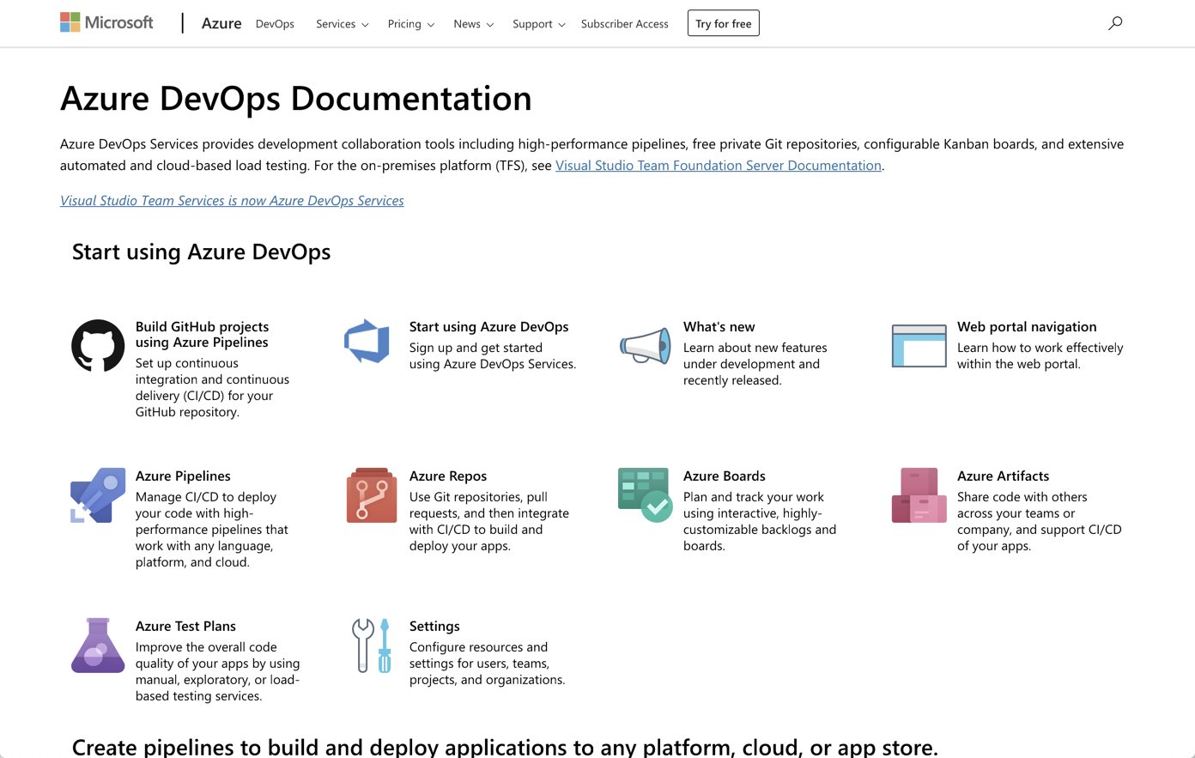
/Docs alert
Azure DevOps documentation has quickstarts and all the reference material you could need
https://aka.ms/AzureDevOpsDocs

Slide 22
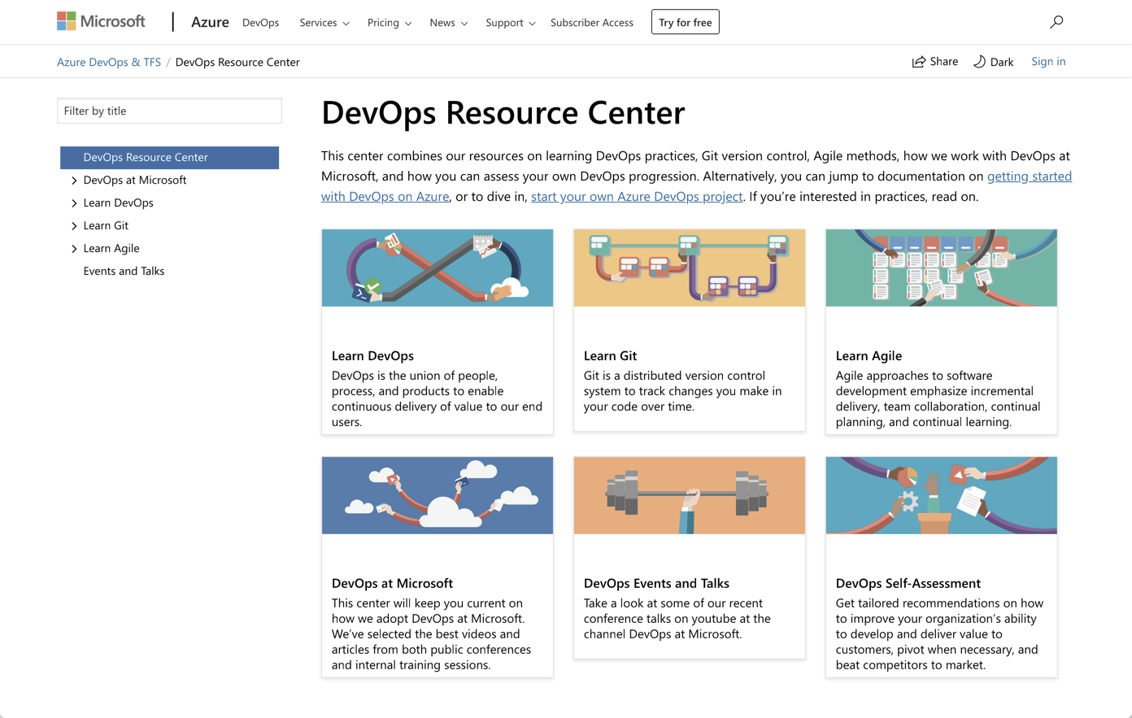
/Docs alert
The DevOps Resource Center is a great starting point for everything DevOps at Microsoft
https://aka.ms/DevOpsResourceCenter

Slide 23
Wrap up
Learned what DevOps is an isn’t
Discovered what Azure can do to support your DevOps journey
Reviewed resources available to get started
Up Next: Deploy a web app using Azure DevOps Pipelines

